Slide 1
UI Mockups: Search/Filter
December 2021

Slide 2
Overview
Inspired by Scholars@Duke interface (uses knowledge graph backend)
This interface driven by VIVO open-source software/ontology
Objectives
Landing page for users to begin exploration into MaterialsMine
Ability to navigate from a high-level overview of knowledge graph, to instance-level information about resources in the knowledge graph
Modularize development of interface

Slide 3
Layered views, from Types to Instances
Gallery of types
Search bar
Overview
Shows types (classes) of resources available
Gallery/list of instances
Facets for filtering
Filter Instances
Enables filtering of instances to those of interest
Instance-Level Views
Templated HTML views
Provides information about a given resource in detail
May contain hyperlinks to other instance views
Chart
Article
Sample
Image, etc.

Slide 4
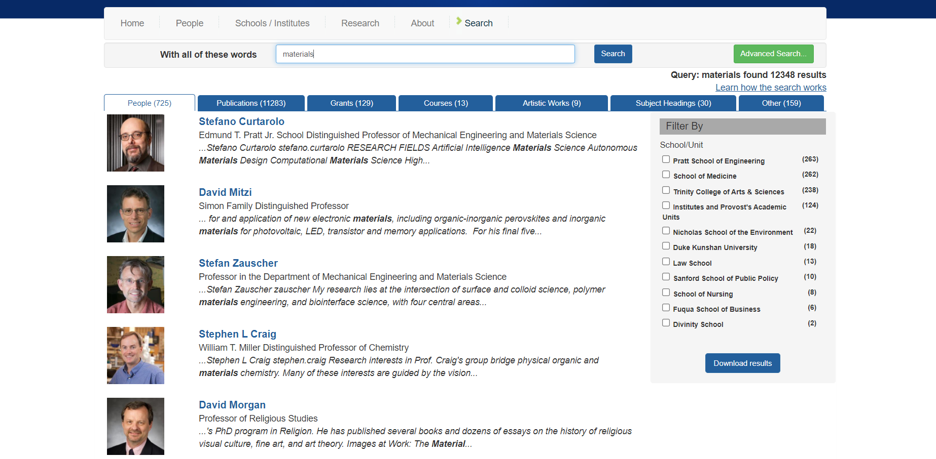
Scholars@Duke example UI (e.g., search “materials” on front page to see this)
Search bar carried over from landing page
Tabs representing other types of resources that match search term
Filter by facet (in this example, by School)
List view with Depiction, Name, Position, snippet of text containing search term

Slide 5
Design Q’s to ask for MaterialsMine…
What types (classes) of resources will people want to search for?
E.g., Articles, Samples, Images, Charts, …
For each type, what is the preferred aggregated view for instances of that resource type?
E.g., List, Simple Gallery, Knowledge Card Gallery, Table, …
Given a set of instances of a given type, what facets are most effective for narrowing down to the instances of interest to the user?
E.g., Article: materials studied, characterization techniques used, properties reported, year published, …
What/how resources indexed (for search bar purposes)

Slide 6
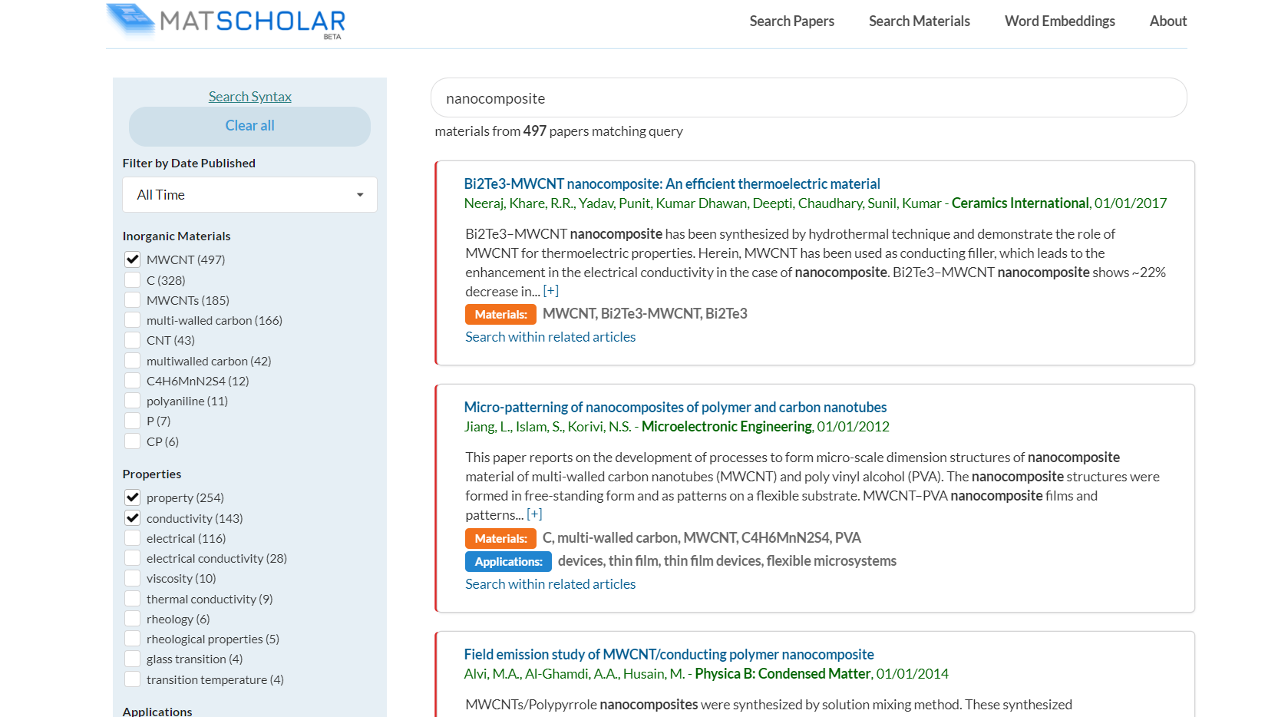
See Matscholar for example UI that dynamically filters articles from a set of facets
Facet types should be reflected in the knowledge graph (e.g., “applications” is not a curated attribute for papers in MaterialsMine, so would not be included as a facet for filtering)

Slide 7
Articles ( )
Samples ( )
Images ( )
Charts ( )
Materials ( )
Title of Article
Filter By
Ordered Author List
Material
Journal Name (Year)
DOI:
Title of Article
Characterization Technique
Ordered Author List
Journal Name (Year)
DOI:
Title of Article
Measured Property
Ordered Author List
Journal Name (Year)
DOI:
Processing Method
Title of Article
Ordered Author List
Year Published
Journal Name (Year)
DOI:
Title of Article
Ordered Author List
Journal Name (Year)

Slide 8
Articles ( )
Samples ( )
Images ( )
Charts ( )
Materials ( )
(optional depiction)
Sample label (SETLr-generated)
Filter By
Sample label (curator-provided)
Abbreviated Author List, DOI:
Material
(optional depiction)
Sample label (SETLr-generated)
Sample label (curator-provided)
Abbreviated Author List, DOI:
Measured Property
(optional depiction)
Sample label (SETLr-generated)
Sample label (curator-provided)
Abbreviated Author List, DOI:
Processing Method
(optional depiction)
Sample label (SETLr-generated)
Sample label (curator-provided)
Abbreviated Author List, DOI:
Composition (Filler Vol. Fraction)
(optional depiction)
Sample label (SETLr-generated)
Sample label (curator-provided)
Abbreviated Author List, DOI:
(optional depiction)
Sample label (SETLr-generated)
Sample label (curator-provided)
Abbreviated Author List, DOI:
(optional depiction)
Sample label (SETLr-generated)
Sample label (curator-provided)
Abbreviated Author List, DOI:

Slide 9
Articles ( )
Samples ( )
Images ( )
Charts ( )
Materials ( )
Filter By
Material
Sample ID:
Sample ID:
Sample ID:
Characterization Technique
Processing Method
Sample ID:
Sample ID:
Sample ID:
Composition (Filler Vol. Fraction)
Sample ID:
Sample ID:
Sample ID:

Slide 10
Articles ( )
Samples ( )
Images ( )
Charts ( )
Materials ( )
Filter By
Live data (SPARQL query)
Static data (csv file)
Title
Title
Title
Queried Property
Date Added
Keyword Tags
(Metadata “tags” were prototyped, but not fully implemented… but adding such tags could help to search/filter charts; proposed “dct:subject” as the predicate in the chart nanopublication)
Title
Title
Title
Title
Title
Title

Slide 11
Articles ( )
Samples ( )
Images ( )
Charts ( )
Materials ( )
Standardized Name (from Chemprops)
Filter By
Unique Alternate Names: [list]
Role in Nanocomposite
Standardized Name (from Chemprops)
(matrix, filler, surface treatment)
Unique Alternate Names: [list]
Category
(thermoplastic, thermoset, elastomer, homopolymer, copolymer, polymer blend…)
Standardized Name (from Chemprops)
Unique Alternate Names: [list]
Standardized Name (from Chemprops)
Unique Alternate Names: [list]
Standardized Name (from Chemprops)
Unique Alternate Names: [list]
Standardized Name (from Chemprops)
Unique Alternate Names: [list]

Slide 12
Templated HTML views
If a user clicks on an item in the search interface, they should be taken to its page, or templated view
Each class has its own template, designed to display the most relevant information for a given instance of the class
Refer to Observable demo (Article View) for example ecosystem
Templated views are ecosystem of linked pages, where each page represents an instance of a particular class
Articles, Samples, Images, Material Classes, Processing Types, can each have their own templated view, with links to other views
E.g., An article view can link to a nanocomposite sample view, which can link to an image view, which can link back to the respective article view, etc.

Slide 13
Other possible classes to include on main page
Datasets
Processing Methods
Characterization Techniques
Other considerations
How to group similar objects (a single “nanocomposite sample” represented by XML metadata vs a “metamaterial sample” represented by a single row in a table of thousands…)
Who are ideal end users? What are their needs? What are best immediate solutions to meet user needs?
What targeted curation efforts can exist (beyond adding more nanocomposite samples), for example supplementing bibliographic metadata or adding scale information to images

